Slide 1


Grocery Store Management System – SQL Project
Name: K Anil Kumar Course: Data Analytics / SQL Institute: Innomatics Research Labs

Slide 2
About me
Background: (MBA Graduate)
Interest: Data Analyst / SQL Analyst.
Reason to learn Data Analytics :
Learning Data Analytics and SQL to build skills in data analysis and business intelligence.
Skills Learned:
- SQL
- Data Analysis
- Data Visualization
- Database Management
GitHub:
Linkedin: linkedin.com/in/k-anil-kumar-49a803338

Slide 3
Objective of the Project
The objective of this project is to design and analyze a Grocery Store Management Database using SQL.
Goals of the project:
Store and manage grocery store data efficiently
Analyze customer purchasing behavior
Identify best-selling products
Evaluate supplier and employee contributions
Analyze sales trends and revenue patterns

Slide 4
Database Structure
The project database consists of 7 tables:
Supplier
Categories
Employees
Customers
Products
Orders
Order Details
Relationships between tables are maintained using Primary Keys and Foreign Keys.
This structure helps maintain data integrity and consistency.

Slide 5
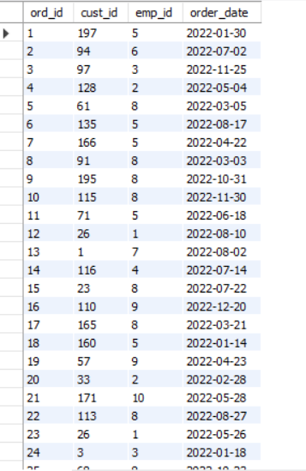
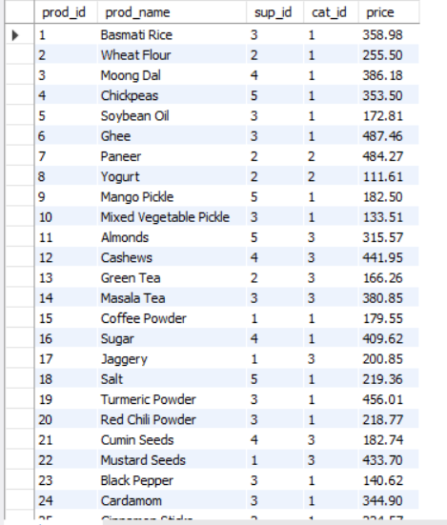
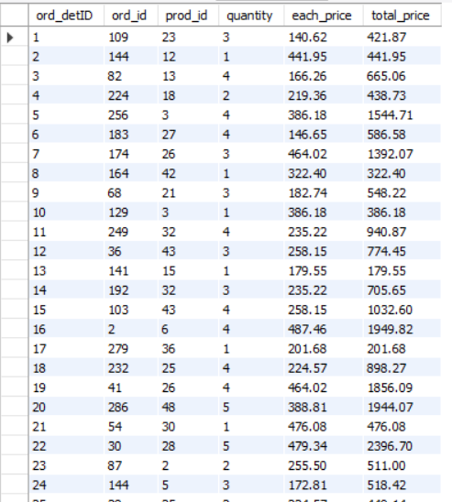
TABLES
Orders
Products
Order_Details

Slide 6
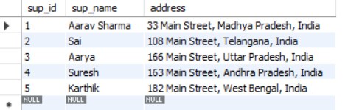
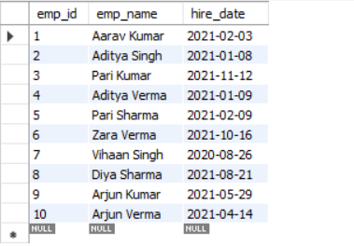
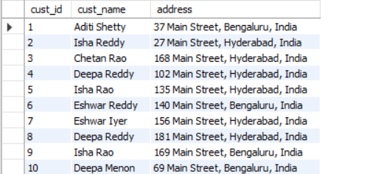
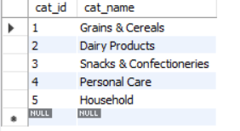
Supplier
Employees
Categories
Customers

Slide 7
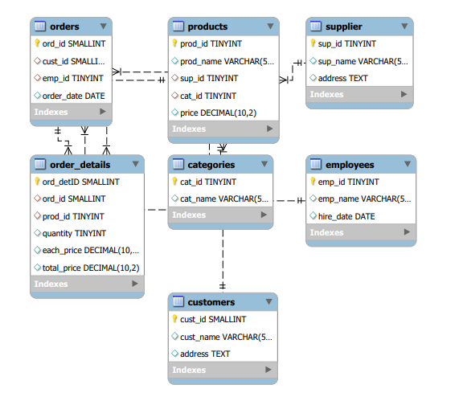
ER Diagram
The Entity Relationship (ER) Diagram represents the structure of the Grocery Store Management database and shows how different tables are connected.

Slide 8
Key Relationships:
One Category can contain multiple Products.
One Supplier can supply multiple Products.
One Customer can place multiple Orders.
One Employee can handle multiple Orders.
One Order can include multiple Products through the Order Details table.

Slide 9


Customer Insights
1. How many unique customers have placed orders?
Query
Output
Explanation:
This query finds the total number of different customers who have placed orders in the store.

Slide 10
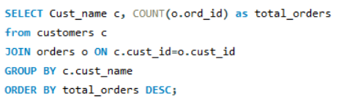
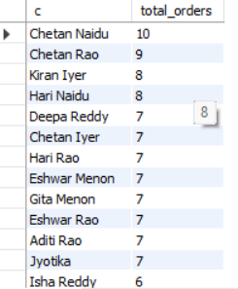
2. Which customers have placed the highest number of orders?
Query
Output
Explanation:
Query identifies customers who placed the most orders, helping to find frequent buyers.

Slide 11
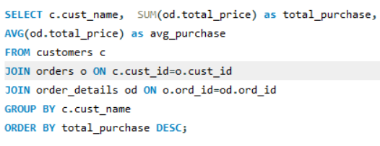
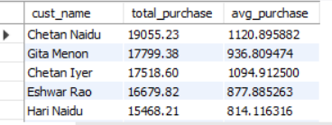
3. What is the total and average purchase value per customer?
Query
Output
Explanation:
calculates how much each customer spent in total and their average purchase value.

Slide 12
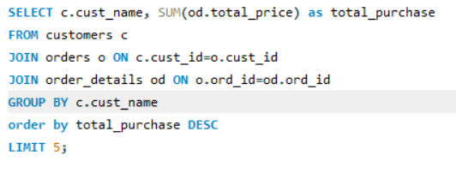
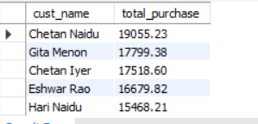
4. Who are the top 5 customers by total purchase amount?
Query
Output
Explanation:
This query shows the top five customers who spent the highest amount in the store.
- These insights help businesses identify loyal and valuable customers.

Slide 13
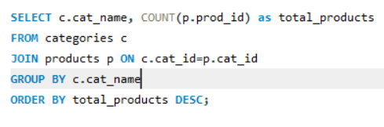
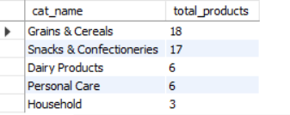
Product Performance
1. How many products exist in each category?
Query
Output
Explanation:
counts the number of products available in each product category.

Slide 14
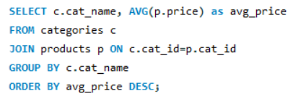
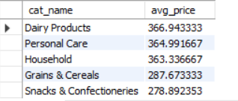
2. What is the average price of products by category?
Query
Output
Explanation:
This query calculates the average price of products in each category.

Slide 15
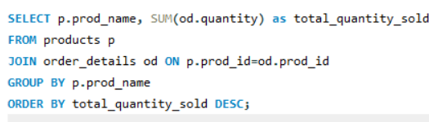
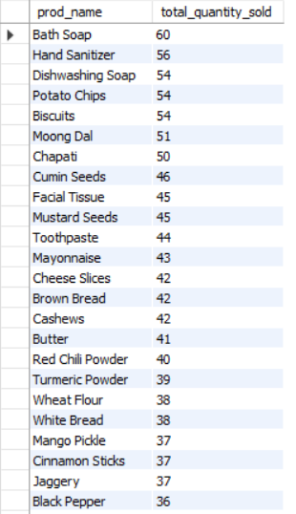
3. Which products have the highest total sales volume (by quantity)?
Query
Output
Explanation:
Query identifies products that are sold the most based on total quantity ordered.

Slide 16
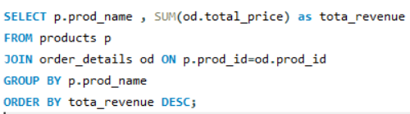
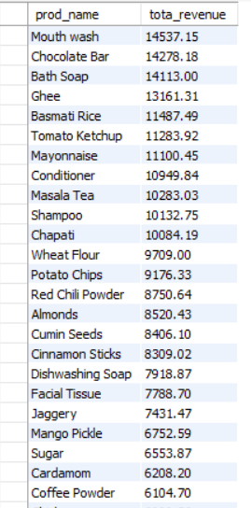
4. What is the total revenue generated by each product?
Query
Output
Explanation:
the total revenue earned from each product.

Slide 17
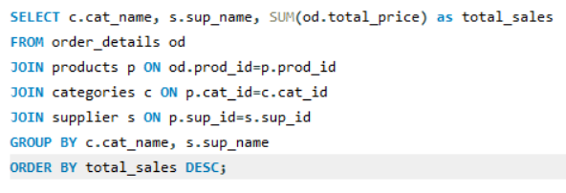
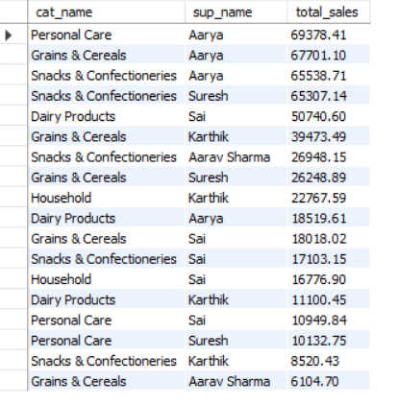
5. How do product sales vary by category and supplier?
Query
Output
Explanation:
This query analyzes product sales across different categories and suppliers to understand their contribution to revenue.
-This helps identify high-demand and profitable products.

Slide 18


Sales & Order Trends
1. How many orders have been placed in total?
Query
Output
Explanation:
counts the total number of orders placed in the grocery store.

Slide 19


2. What is the average value per order?
Query
Output
Explanation:
calculates the average amount spent per order by customers.

Slide 20
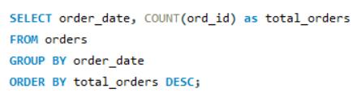
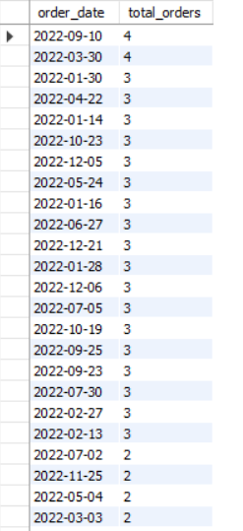
3. On which dates were the most orders placed?
Query
Output
Explanation:
calculates the average amount spent per order by customers.

Slide 21
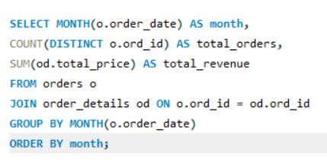
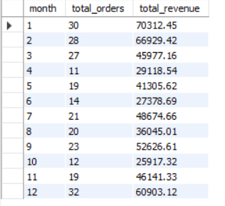
4. What are the monthly trends in order volume and revenue?
Query
Output
Explanation:
It analyzes how order count and revenue change across different months.

Slide 22
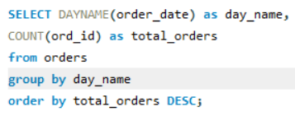
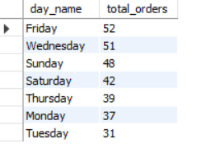
5. How do order patterns vary across weekdays and weekends?
Query
Output
Explanation:
This query compares order patterns between weekdays and weekends to understand customer buying behavior.
-These insights help in business planning and forecasting.

Slide 23


Supplier Contribution
1. How many suppliers are there in the database?
Query
Output
Explanation:
counts the total number of suppliers providing products to the store.

Slide 24
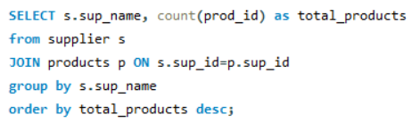
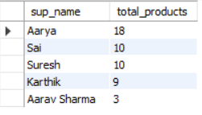
2. Which supplier provides the most products?
Query
Output
Explanation:
This query identifies the supplier who supplies the highest number of products.

Slide 25
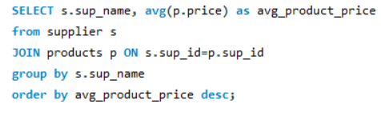
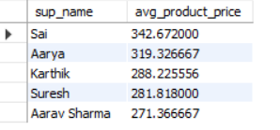
3. What is the average price of products from each supplier?
Query
Output
Explanation:
calculates the average price of products supplied by each supplier.

Slide 26
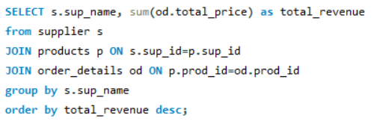
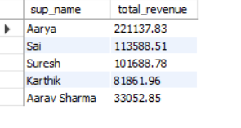
4. Which suppliers contribute the most to total product sales (by revenue)?
Query
Output
Explanation:
This query finds the suppliers who generate the highest revenue through product sales.
-This helps evaluate business operations efficiency.

Slide 27


Employee Performance
1. How many employees have processed orders?
Query
Output
Explanation:
Query counts the number of employees who handled customer orders.

Slide 28
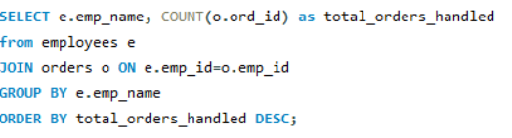
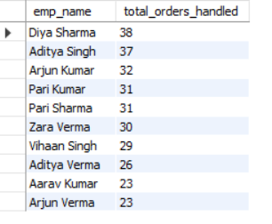
2. Which employees have handled the most orders?
Query
Output
Explanation:
identifies employees who processed the highest number of orders.

Slide 29
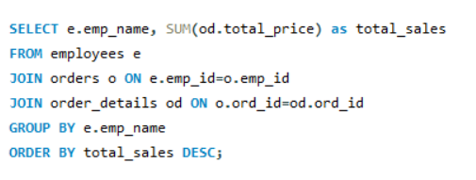
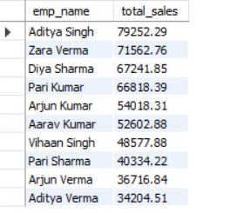
3. What is the total sales value processed by each employee?
Query
Output
Explanation:
calculates the total sales amount handled by each employee.

Slide 30
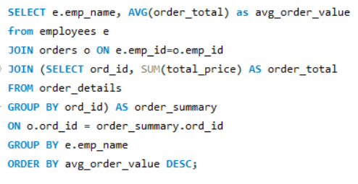
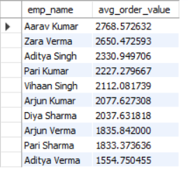
4. What is the average order value handled per employee?
Query
Output
Explanation:
This query calculates the average order value managed by each employee.
-This helps evaluate business operations efficiency.

Slide 31
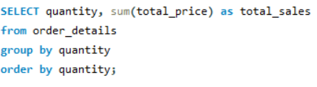
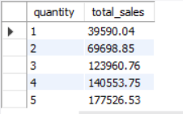
Order Details Deep Dive
1. What is the relationship between quantity ordered and total price?
Query
Output
Explanation:
This query analyzes how the total price changes based on the quantity of products ordered.

Slide 32
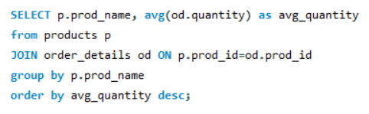
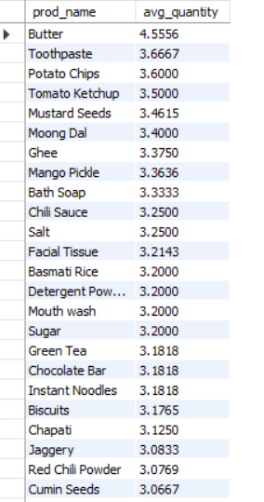
2. What is the average quantity ordered per product?
Query
Output
Explanation:
calculates the average number of units ordered for each product.

Slide 33
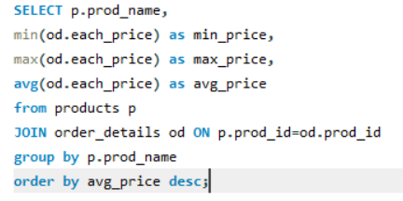
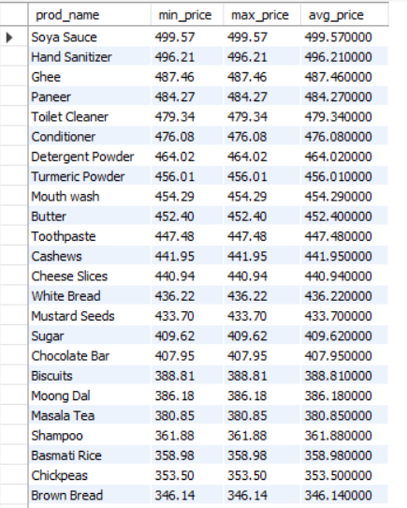
3. How does the unit price vary across products and orders?
Query
Output
Explanation:
This query analyzes how the unit price differs for various products across different orders.
-This helps understand customer purchasing patterns.

Slide 34
Conclusion & Key Findings
This project demonstrates how SQL can be used to analyze business data and generate useful insights for decision-making.
Key findings include:
Identification of top customers and best-selling products
Understanding sales patterns and revenue trends
Evaluating supplier contributions
Measuring employee performance

Slide 35
Challenges Faced
Managing primary keys and foreign keys correctly.
Writing complex SQL queries using joins and aggregations.
Analyzing data from multiple tables to generate insights.

Slide 36
Q&A

Slide 37

THANK YOU

